Slide 1

Employee Management System
D . Srinivasa Rao
V. Sai Eswar
B. Sree Ram

Slide 2
Agenda (This should be the PPT flow)
Objective of the Project
ER Diagram and schema explanation
Key analysis questions (use cases)
SQL query results with screenshots or summaries
Final business insights and recommendations
Conclusion (Key finding overall)
Q&A Slide
Your Experience/Challenges working on SQL – Data Analysis Project.

Slide 3
Objective of the Project
The main objective of this project is to analyze employee-related data using SQL to gain meaningful insights into workforce management and business operations.
It focuses on understanding employee distribution, salary structure, job roles, qualifications, leave patterns, and overall payroll performance.
By examining relationships between different tables such as JobDepartment, Employee, SalaryBonus, Qualification, Leaves, and Payroll, the project aims to identify trends that can support better decision-making in human resource planning and financial management.
Ultimately, the goal is to transform raw employee data into actionable insights that enhance organizational efficiency and employee productivity.

Slide 4
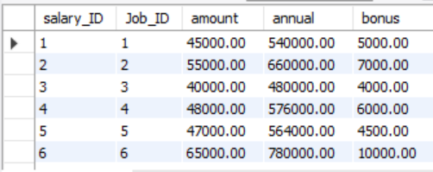
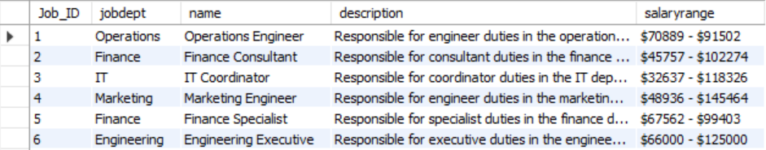
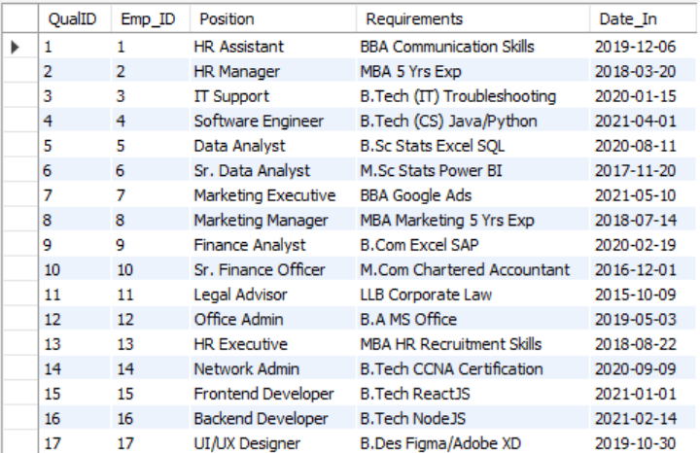
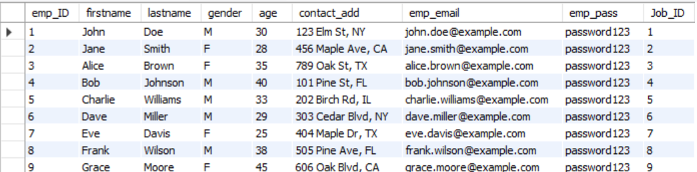
Tables
JobDepartment
SalaryBonus
Employee
Qualification

Slide 5
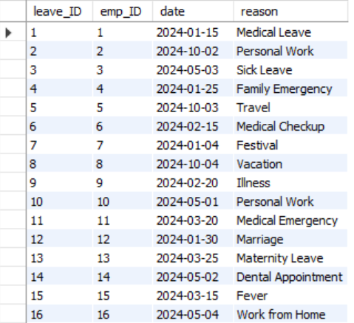
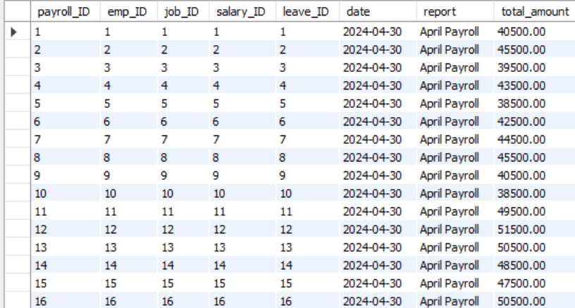
Leaves
Payroll

Slide 6
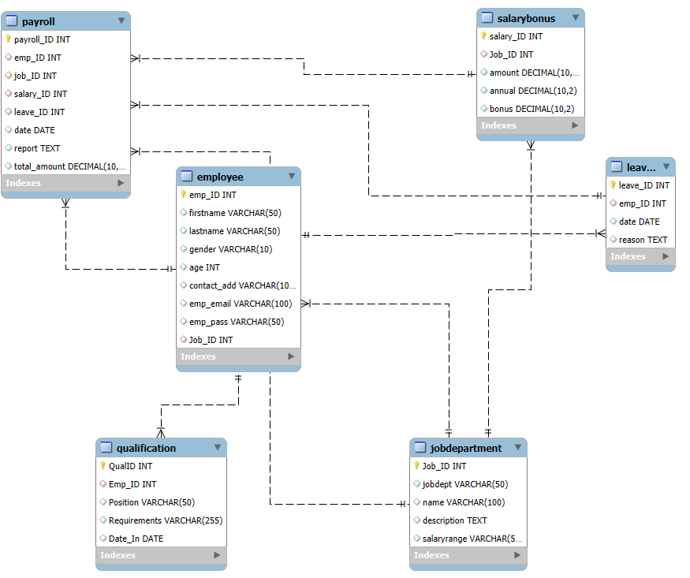
ER Diagram

Slide 7
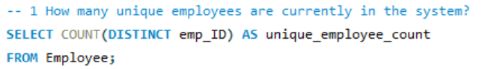
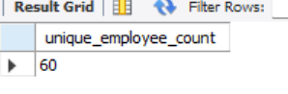
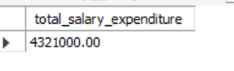
SQL query results with screenshots
1. EMPLOYEE INSIGHTS
2.What is the total salary expenditure across the company?

Slide 8
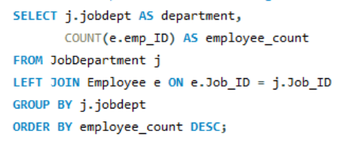
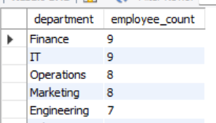
3. Which departments have the highest number of employees?

Slide 9
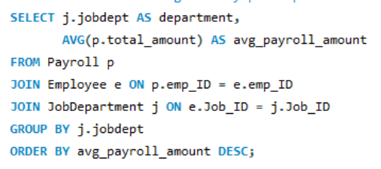
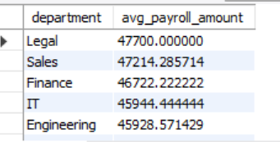
4. What is the average salary per department?

Slide 10
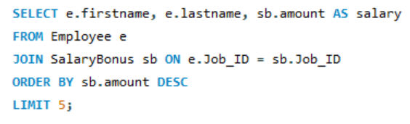
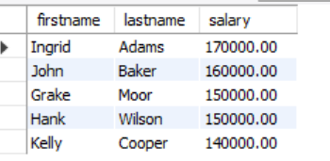
5. Who are the top 5 highest-paid employees?

Slide 11
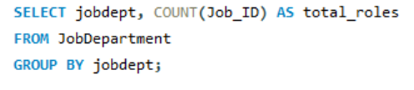
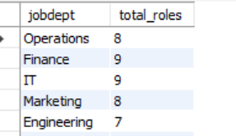
2. JOB ROLE AND DEPARTMENT ANALYSIS
1. How many different job roles exist in each department?

Slide 12
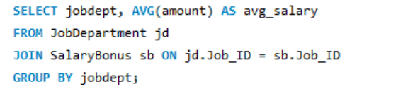
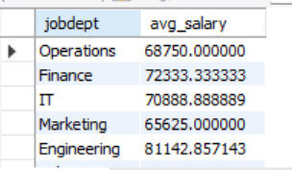
2. What is the average salary range per department?

Slide 13
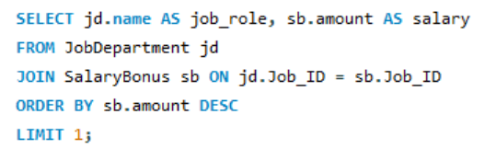
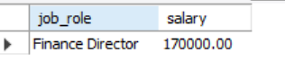
3. Which job roles offer the highest salary?

Slide 14
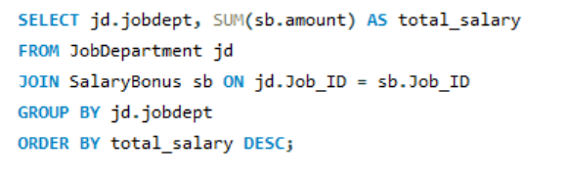
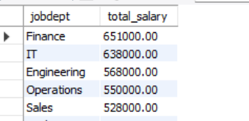
4. Which departments have the highest total salary allocation?

Slide 15
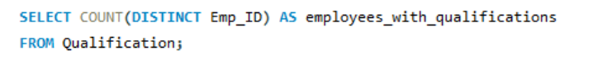
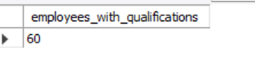
3. QUALIFICATION AND SKILLS ANALYSIS
1. How many employees have at least one qualification listed?

Slide 16
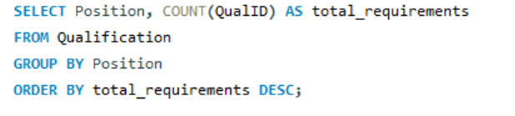
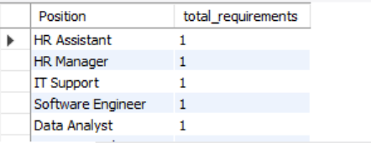
2. Which positions require the most qualifications?

Slide 17
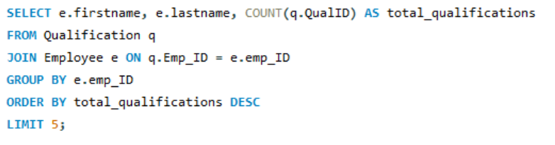
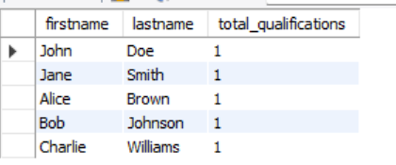
3. Which employees have the highest number of qualifications?

Slide 18
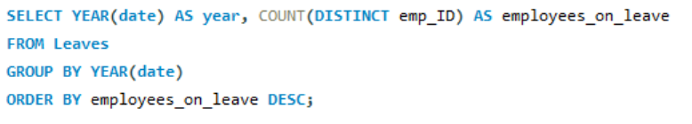
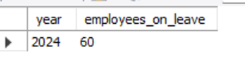
4. LEAVE AND ABSENCE PATTERNS
1. Which year had the most employees taking leaves?

Slide 19
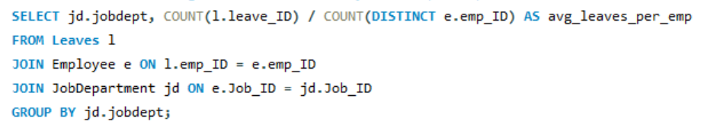
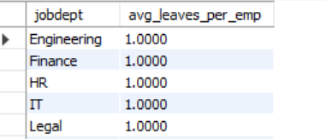
2. What is the average number of leave days taken by its employees per department?

Slide 20
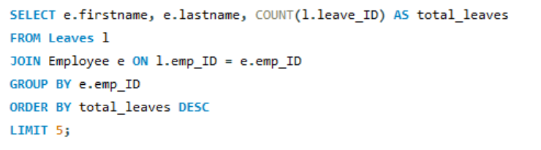
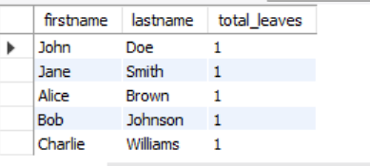
3. Which employees have taken the most leaves?

Slide 21
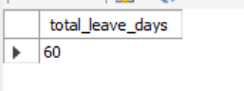
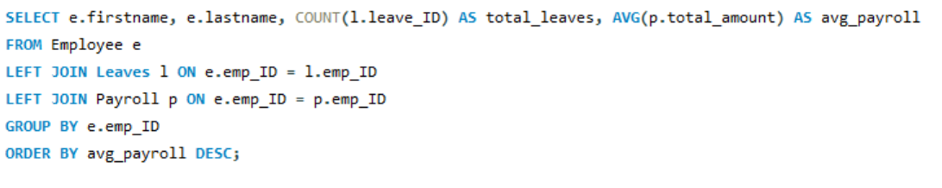
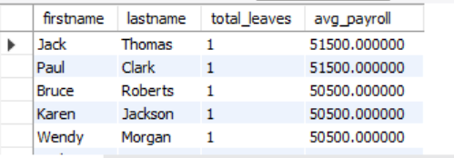
4.What is the total number of leave days taken company-wide?
5. How do leave days correlate with payroll amounts?

Slide 22
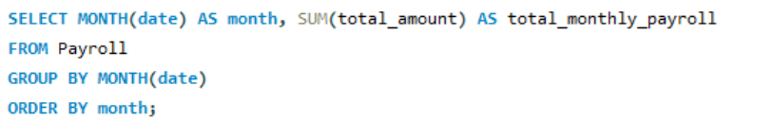
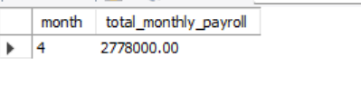
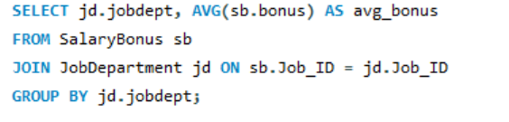
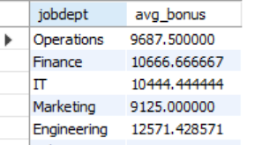
5. PAYROLL AND COMPENSATION ANALYSIS
1. What is the total monthly payroll processed?
2. What is the average bonus given per department?

Slide 23
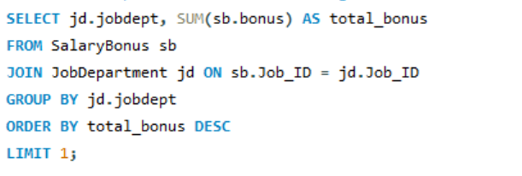
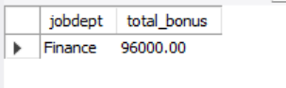

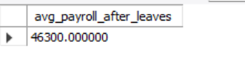
3. Which department receives the highest total bonuses?
4. What is the average value of total_amount after considering leave deductions?

Slide 24
Final business insights and recommendations
Departments with more employees may require additional resources and better management oversight.
Highest-paid roles indicate key positions; these employees should be retained and motivated.
Average salaries and total salary expenditures help in budget planning and financial forecasting.
Employees with multiple qualifications can be considered for promotions or critical projects.
Tracking leaves and absence patterns helps in workforce planning and minimizing productivity loss.
Payroll and bonus analysis can optimize compensation strategies and reward performance effectively.
Data-driven insights support HR decisions in recruitment, training, and role allocation.
Monitoring employee trends ensures better operational efficiency and organizational growth.

Slide 25
Conclusion (Key finding overall)
The database efficiently organizes employee, department, payroll, leave, and qualification data.
Salary and bonus analysis revealed key high-paying roles and departments with major expenditures.
Employee qualifications and leave patterns provide insights for training and workforce planning.
Payroll tracking ensures accurate compensation and highlights trends for financial planning.
Data-driven insights support better HR decisions, resource allocation, and employee management.
Overall, the system enables informed decision-making, improves operational efficiency, and enhances organizational performance.

Slide 26
Experience & Challenges
Gained hands-on experience in designing and managing relational databases with multiple tables.
Learned to write complex SQL queries for analysis, aggregation, and joins.
Understood relationships between tables and how foreign keys maintain data integrity.
Faced challenges in query optimization for faster results on large datasets.
Learned to handle data consistency issues while linking payroll, leaves, and employee records.
Improved problem-solving skills and ability to extract actionable insights from raw data.

Slide 27


Slide 28

THANK YOU

